Slide 1


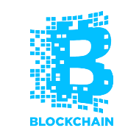
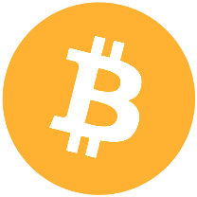
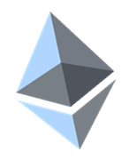

Notable Blockchain Projects
Steem, Storj, Lockchain, AdEx, Propy, Maidsafe, Augur, Gnosis, Aragon
Ilin Kazandzhiev
Technical Writer
Academy School of Blockchain
http://kingsland.academy

Slide 2

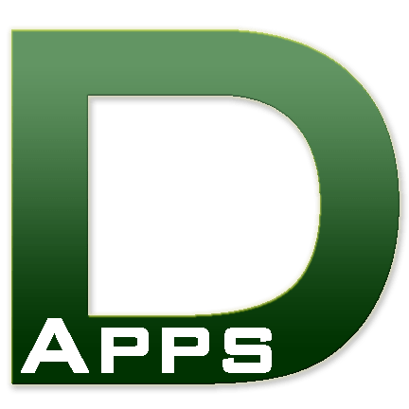

Table of Contents
Decentralized Apps (DApps)
Notable Blockchain Projects
Decentralized Prediction Markets
Anonymous Marketplaces

Slide 3
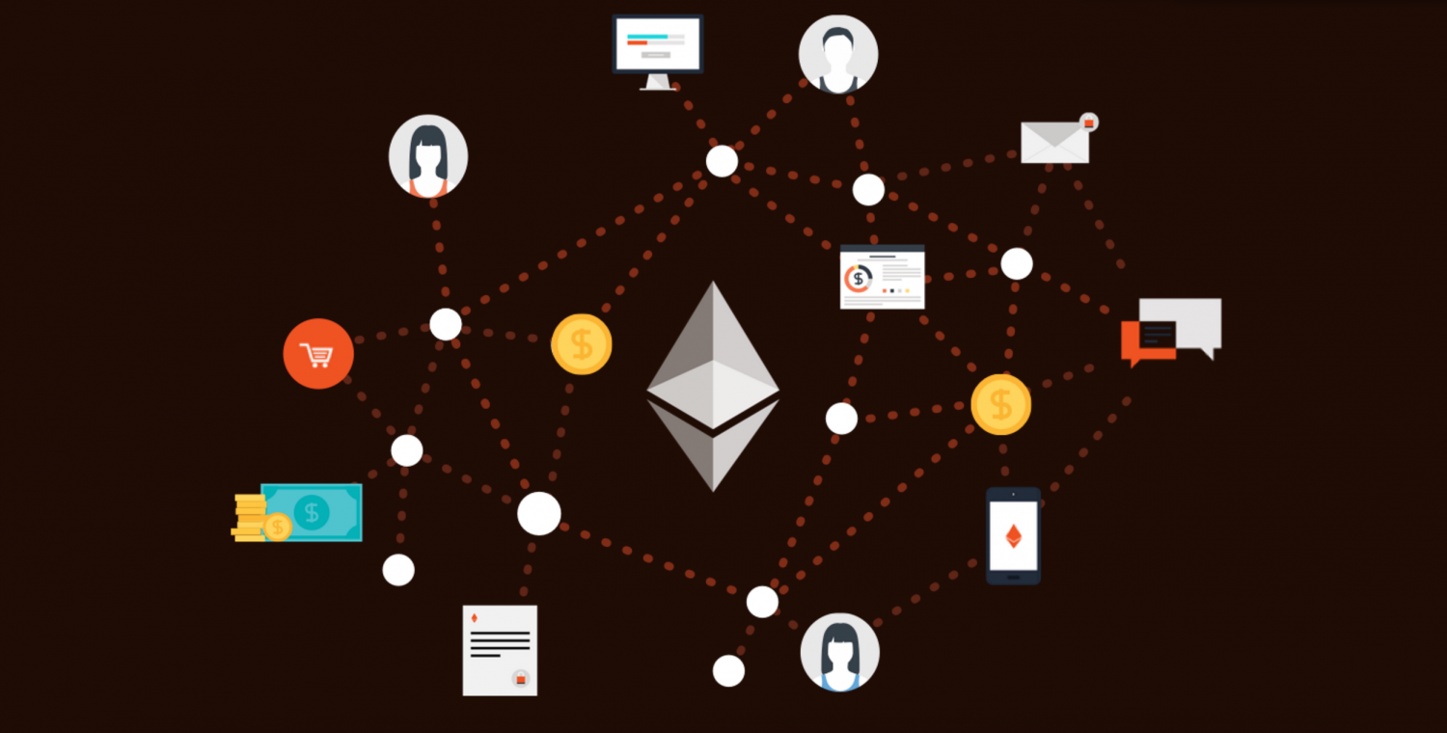
Decentralized Apps

Slide 4
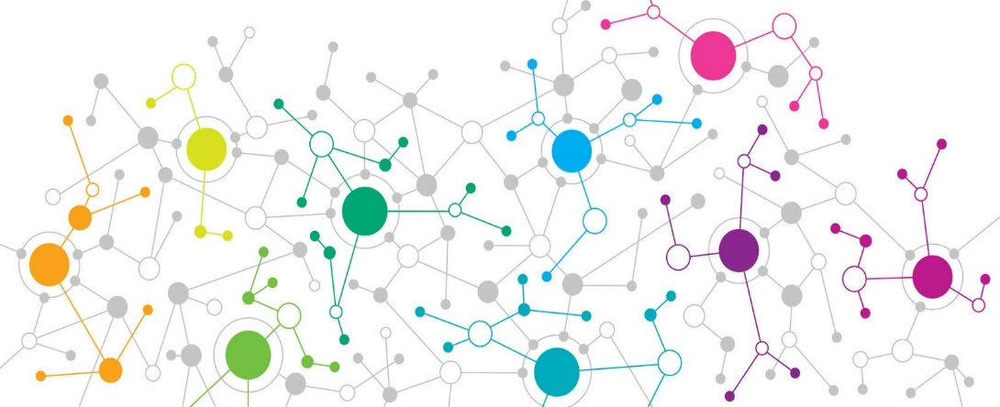
Decentralized Blockchain Apps (DApps)
DApps
DApps hold backend code and data on the blockchain
The front-end is still a traditional app
Client App (front-end)
Traditional Backend Server-side code + data
Smart Contract Backend Code + data on the blockchain

Slide 5
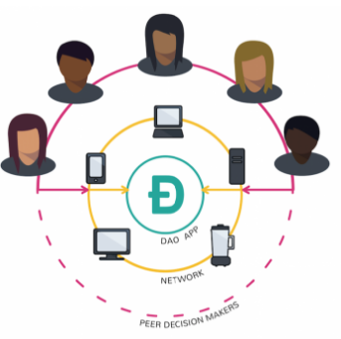
What are decentralized apps (DApps)?
Types of DApps based on Ethereum
Apps that manage money
Apps which mixes money with information from outside the blockchain
Category “other” apps, which includes voting and governance systems
Notes:
The ethereum white paper splits dapps into three types: apps that manage money, apps where money is involved (but also requires another piece), and apps in the “other” category, which includes voting and governance systems.
In the first type of app, a user may need to exchange ether as a way to settle a contract with another user, using the network's distributed computer nodes as a way to facilitate the distribution of this data.
The second type of app mixes money with information from outside the blockchain.
For example, a crop insurance application that's dependent on an outside weather feed. To execute, these smart contracts rely on so-called “oracles” that relay up-to-date information about the outside world
If bitcoin can do away with financial authorities, is it possible to do the same for companies and other types of organizations?
The goal is form a leaderless company, program rules at the beginning about how members can vote and how to release company funds

Slide 6

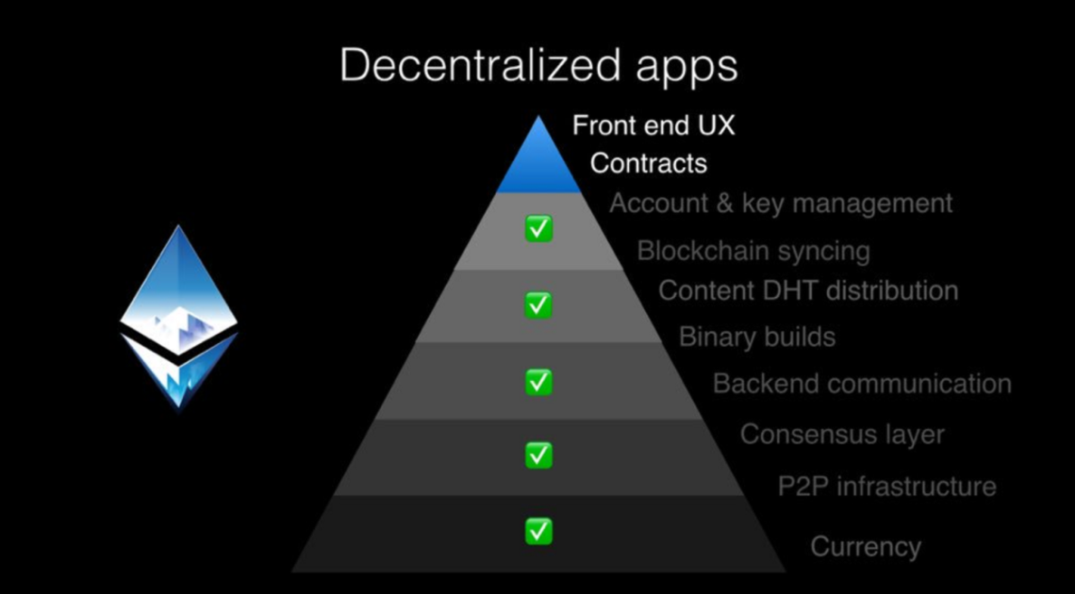
What are decentralized apps (DApps)?
Common features of DApps
Open Source
Decentralized
Incentivized
Protocol
Notes:
Open Source. Ideally, it should be governed by autonomy and all changes must be decided by the consensus, or a majority, of its users. Its code base should be available for scrutiny.
Decentralized. All records of the application’s operation must be stored on a public and decentralized blockchain to avoid pitfalls of centralization.
Incentivized. Validators of the blockchain should be incentivized by rewarding them accordingly with cryptographic tokens.
Protocol. The application community must agree on a cryptographic algorithm to show proof of value. For example, Bitcoin uses Proof of Work (PoW) and Ethereum is currently using PoW with plans for a hybrid PoW/Proof of Stake (PoS)5 in the future. If we adhere to the above definition, the first Dapp was in fact Bitcoin itself. Bitcoin is an implemented blockchain solution that arose from problems revolving around

Slide 7

Notable Blockchain Projects

Slide 8

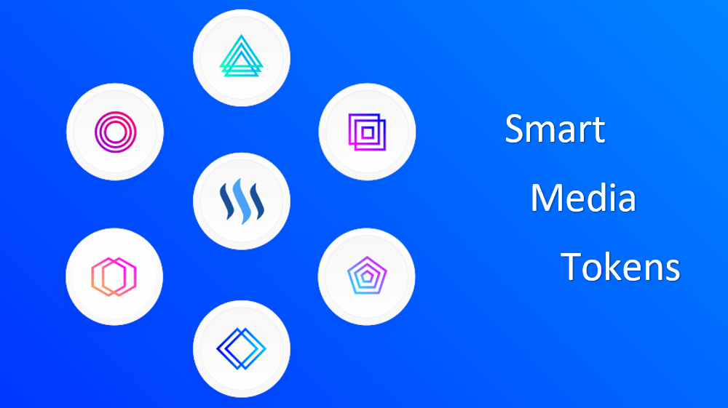
Steem – A Blockchain-Based Rewards Platform
SteemIt – https://steemit.com
A social network that pays its community
Steem concept: contribution to the community should be recognized for the value it adds – steemdb.com
The Steem blockchain has two tokens: STEEM and Steem Dollars
https://steem.io

Slide 9
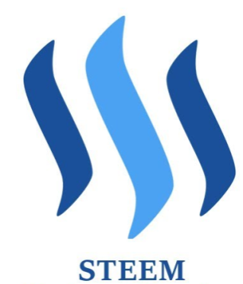


Steemit Currency Units
Steem (STEEM) – can be bought, sold for money or can be traded
Steem Dollars (SBD) – a market-powered token used for upvoting posts on Steemit
Steem Power – provides the opportunity to have ownership in the network

Slide 10
Decentralized Storage Platforms
IPFS
A peer-to-peer decentralized storage system
Not a blockchain, but is decentralized
https://ipfs.io
https://ipfs.io/docs/api/ – API Docs
Storj
https://storj.io
Incentivized peer-to-peer decentralized storage

Slide 11
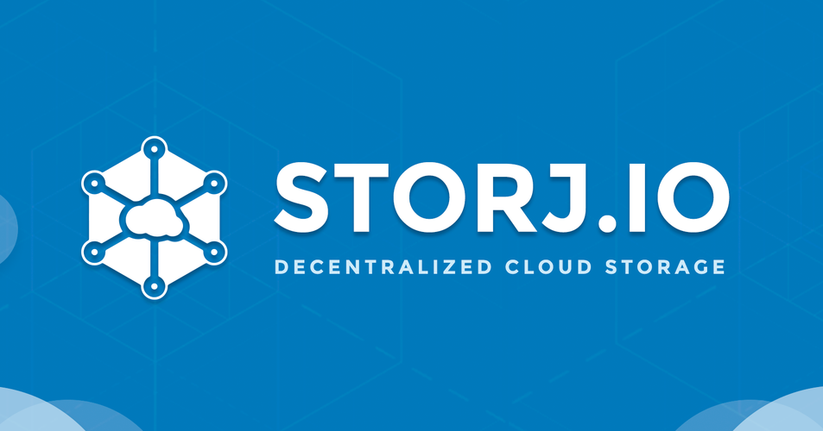
Storj – Decentralized Storage
Decentralized and encrypted cloud storage system
Based on blockchain technologies
End-to-end encryption
Peer-to-peer technology
Open-source cloud platform
https://storj.io
Notes:
Storj presents itself as a decentralized and encrypted cloud storage system based on blockchain technologies.

Slide 12
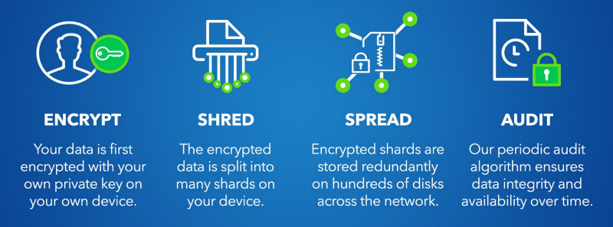
Storj – Decentralized Storage (2)
Notes:
Storj presents itself as a decentralized and encrypted cloud storage system based on blockchain technologies.

Slide 13
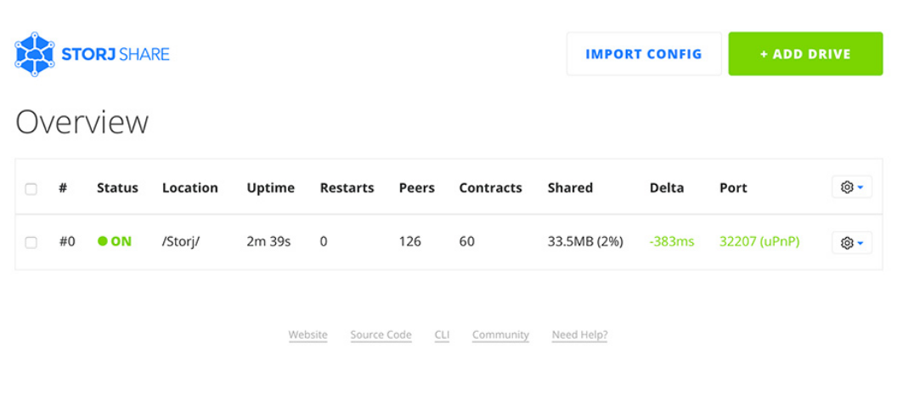
Earn Money by Sharing Hard Drive Space
https://storj.io/share.html

Slide 14
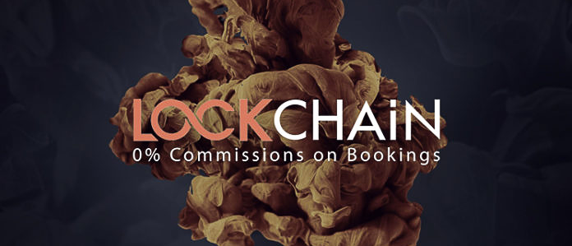
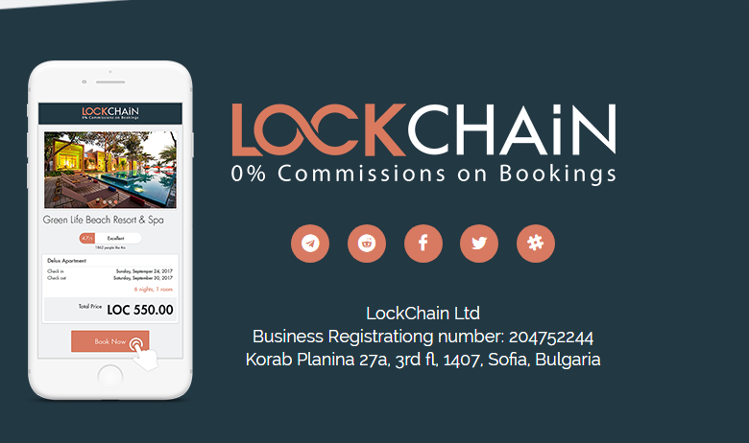
Lockchain – Blockchain Powered Marketplace
Decentralized booking platform
Connects property owners with renters through the blockchain
https://lockchain.co
Technology based on Ethereum smart contracts
https://github.com/LockChainLtd
Notes:
Seamless Integration For Property Owners
Property owners and hoteliers will be able to add their short term rentals and hotel rooms to the decentralized LOC ecosystem through a one-click seamless integration

Slide 15
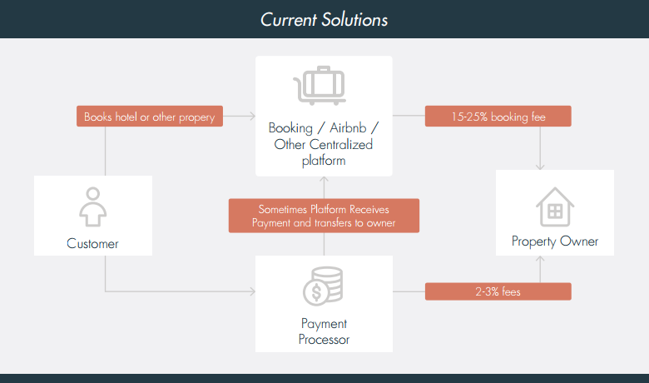
Lockchain – The Booking Industry Now
Notes:
Seamless Integration For Property Owners
Property owners and hoteliers will be able to add their short term rentals and hotel rooms to the decentralized LOC ecosystem through a one-click seamless integration

Slide 16
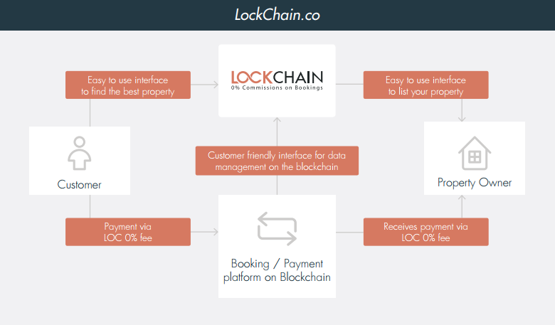
Lockchain – Decentralizing Property Industry
Notes:
A visual representation of how the industry works now and how LockChain aims to revolutionize it, stepping on a decentralized foundation layer through user friendly

Slide 17
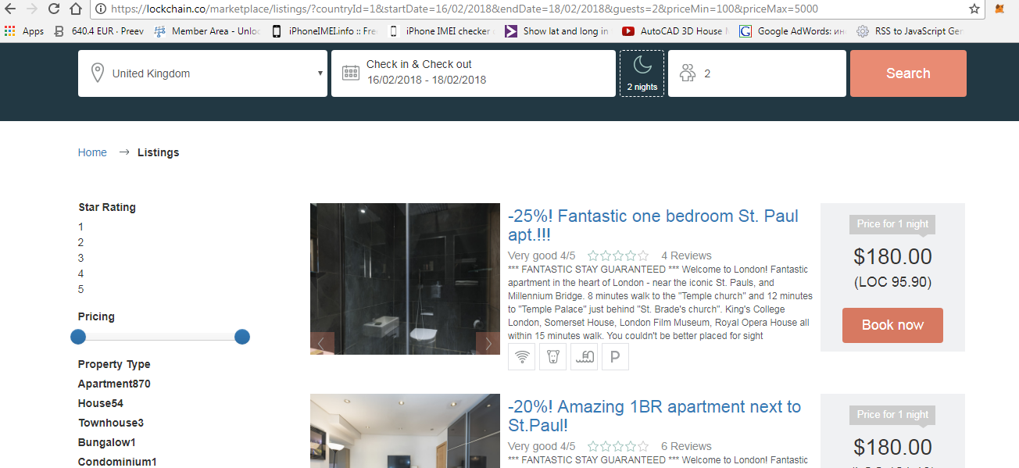
Lockchain Marketplace
https://alpha.lockchain.co

Slide 18
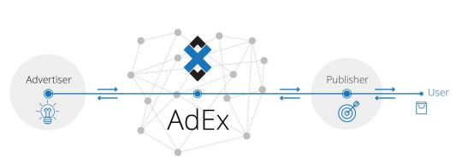
AdEx – A Decentralized Ad Exchange
Ad exchange built on Ethereum smart contracts
DApps for the publisher, advertiser and AdEx end users
Browser-based DApps and easily accessible online
https://adex.network
Notes:
The AdEx Network has several layers:
the first one is the ad exchange, which is built on Ethereum smart contracts with a few solutions for a quicker layer on top of that (or side-by-side) being experimented upon. The ad exchange is built in a way to facilitate the entire relationship between publishers, advertisers and end users, therefore replacing the usual network of multiple exchanges, SSPs and DSPs and all the complexity, inaccurancy and inefficiency that comes with it.
On top of the exchange, we are building dapps for the publisher portal, advertiser portal and the AdEx profile (for end users). Dapps are distributed applications that connect to the Ethereum blockchain and interact with it, but typically with a user-friendly user interface. All of those dapps will be browser-based and easily accessible online, hosted by AdEx - but since they're interacting with the blockchain directly, anyone can run their own instance of those dapps if they want to.

Slide 19
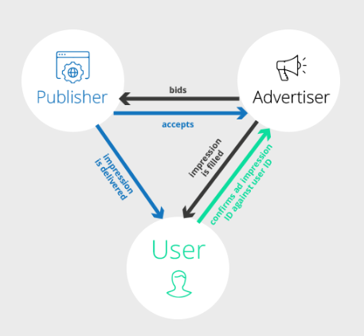
AdEx – Architecture
Existing real-time bidding platforms offer no information about ad bids
The solution might be a decentralized​ ​exchange​ ​that ​can​ ​be​ ​audited
Notes:
Existing real-time bidding (RTB) platforms offer no information about ad bids whatsoever.
This means that an advertiser is told the maximum bid for a particular ad property is $X but
is not given the opportunity to verify this.
Due to the fact that AdEx is based on blockchain, advertisers can easily trace every
click/view and verify every component of a campaign (participants, ad placements,
impressions and clicks, etc.). The information is decentralized so it can’t be hogged or
manipulated by the ad exchange so advertisers are only paying for actual results.

Slide 20
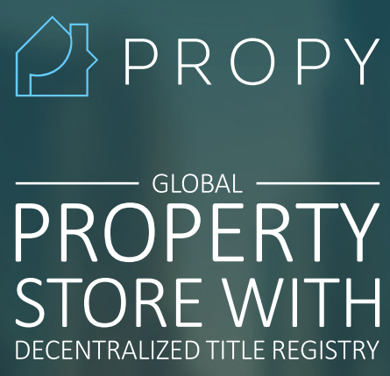
Propy – Find The Best Investment Properties
Dedicated to solving the property problems
Purchasing property across the borders
Propy integrates blockchain ledger to make title deeds issuance instantly
https://github.com/Propy/
https://propy.com

Slide 21
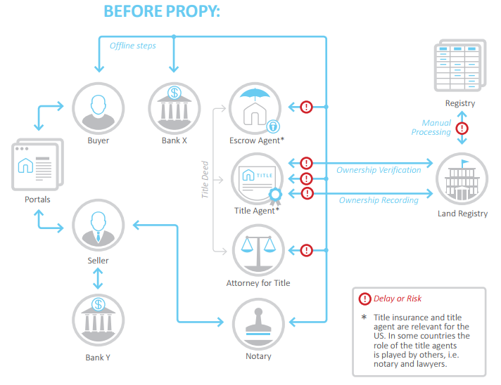
Propy – Legacy Title Transfer
Notes:
Propy intends to initially conduct business and thus, the current development of Propy is geared towards
mirroring government records in the blockchain with the goal of providing a platform for foreign real estate investors to conveniently
and remotely carry out property transactions. The Propy Registry acts as a source of fast delivered evidence of property transfer for
brokers and serves as a mirror of the ownership transfers currently taking place at the title registries of the targeted markets (U.S., UK,
UAE). Brokers who focus on foreign real estate investments, have expressed the need to have available technology that could allow the online processing of real estate purchases with the additional layers of security that the Propy Registry intends to provide. The second legislative environment would arise when progressive governments start recognizing the benefits of ownership transfers on blockchain as a more desirable alternative instead of trying to continue to enhance the existing real estate registries. The widespread adoption of a blockchain system to manage real estate titles positions Propy to provide a sole, decentralized source of validation for real estate transactions.

Slide 22
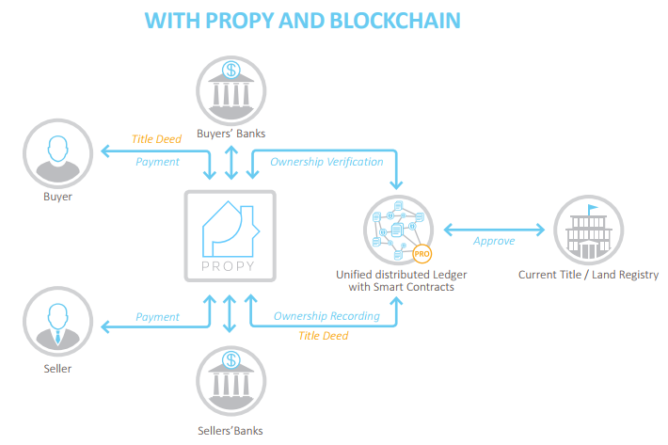
Propy – Interaction On The Blockchain
Notes:
Each property has a unique title that serves as evidence of ownership. The
ownership of properties is usually tracked by the recordation of such titles in
organized property registries which are managed by regional governmental
organizations. As previously discussed, Propy aims to develop the Propy
Registry with the ultimate goal of becoming a global registry for title deed
ownership information, which would be made available to worldwide
entities, similar to a DNS system for website domains.

Slide 23

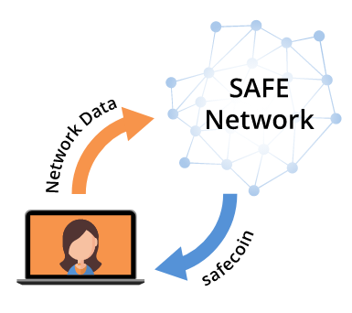
MaidSafe – Blockchain App Hosting
Decentralized blockchain hosting network
Hosts sites and app, like in the cloud
Farmers provide resources (CPU, HDD, network)
Earn coins for their services
Hosting users host sites and apps
Pay coins to host site / app / data
Users browse the sites in the network
https://maidsafe.net

Slide 24
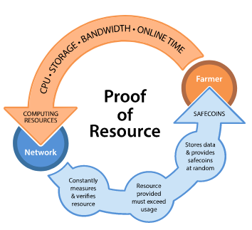
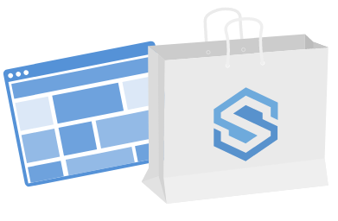
MaidSafe Network
Proof of Resource
Checked by the network to make sure that the resource is still available
A new market place
Payment going directly to the application developer
A market of buyers and sellers – farmers can sell the coins they earn for another currency
Notes:
The resource provided by each Farmer is continually checked by the network to make sure that it is still available. It does this by attempting to store a random piece of data. Should the network ﬁnd that the resource committed to the network is no longer available, it reduces the rank of the vault thereby reducing the earning potential of that speciﬁc Vault.
Safecoins can be used to access and use network applications, with part of the ‘payment’ going directly to the application developer. Safecoins can also be bought by users unwilling, or unable to provide resource to the network. This creates a market of buyers and sellers so that farmers can sell the coins they earn for another currency. These transactions will take place on an exchange, another SAFE Network application, or directly between individuals.

Slide 25
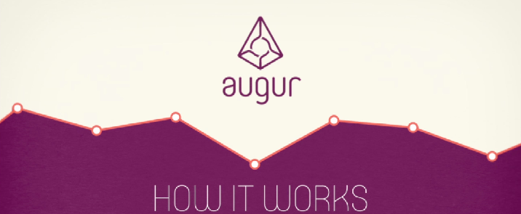

Augur – Decentralized Prediction Markets
Prediction market platform
You buy virtual shares but you can earn real money
Prediction markets rests in the idea of the "The Wisdom of the Crowd"
https://www.augur.net

Slide 26
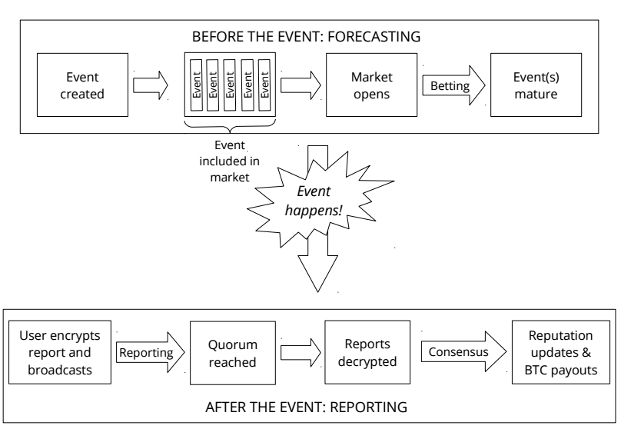
Augur – Outline Of Actions in a Prediction Market

Slide 27
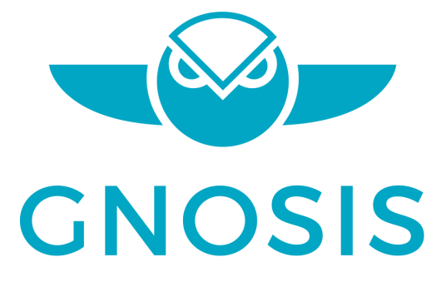
Gnosis – Crowdsourced Wisdom
Hosting and interfacing with decentralized prediction markets
Incorporating reliable data into the system
Gnosis allows references from external platforms to settle outcome of an event
https://gnosis.pm
Notes:
Seamless Integration For Property Owners
Property owners and hoteliers will be able to add their short term rentals and hotel rooms to the decentralized LOC ecosystem through a one-click seamless integration

Slide 28
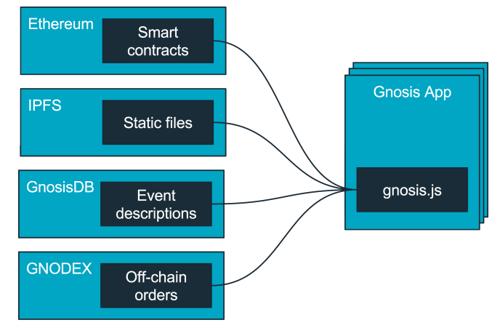
Gnosis Architecture
Ethereum allows to run decentralized code with smart contracts
IPFS allows to store static files in a distributed file system
GnosisDB tries to compensate the shortcomings of Ethereum and IPFS
GNODEX is a decentralized exchange to trade predictive assets
Notes:
Ethereum allows to run decentralized code with smart contracts, making transfer and settlement of assets simple and censorship resistant. Gnosis is using Ethereum for creation of events and markets. Every prediction market trade and every settlement is ultimately done on this layer.
IPFS allows to store static files in a distributed file system. It is using distributed hash tables to distribute files. Gnosis is using IPFS to store all static files gnosis.js or any UI element. In addition meta information of events is stored in IPFS.
GnosisDB tries to compensate the shortcomings of Ethereum and IPFS, which come without search capabilities. GnosisDB offers a distributed, scalable search combining on-chain with off-chain data and will be used to query event descriptions of prediction markets.
GNODEX is a decentralized exchange to trade predictive assets (prediction market outcome tokens) using state channels. State channels allow to scaleout transaction capacity of Ethereum, which is needed to make Gnosis prediction markets accessible to a large scale of users.

Slide 29
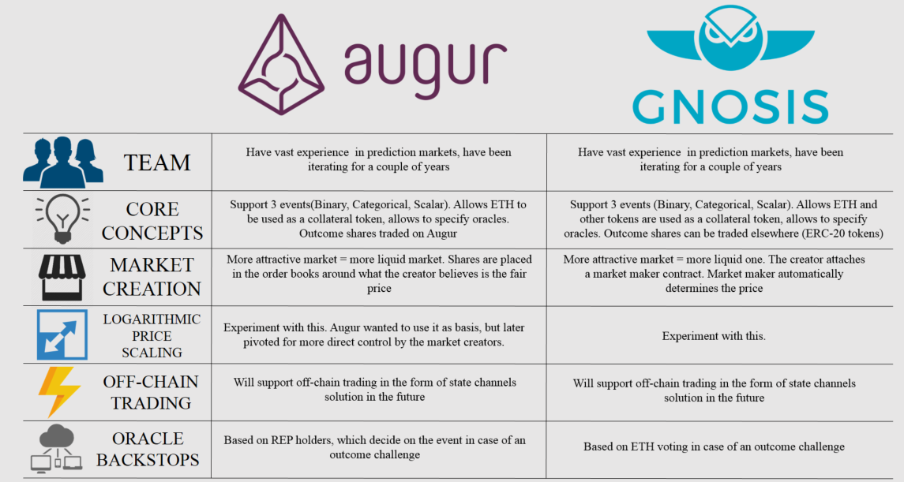
Augur vs. Gnosis Comparison

Slide 30
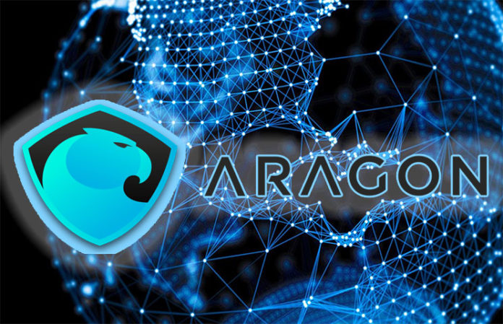
Aragon – Fighting for the Freedom to Organize
Decentralized autonomous organization (DAO)
Aragon – decentralized organizations are more efficient than centralized
Ability to wrap and unwrap tokens in voting and ownership entity
https://aragon.one

Slide 31
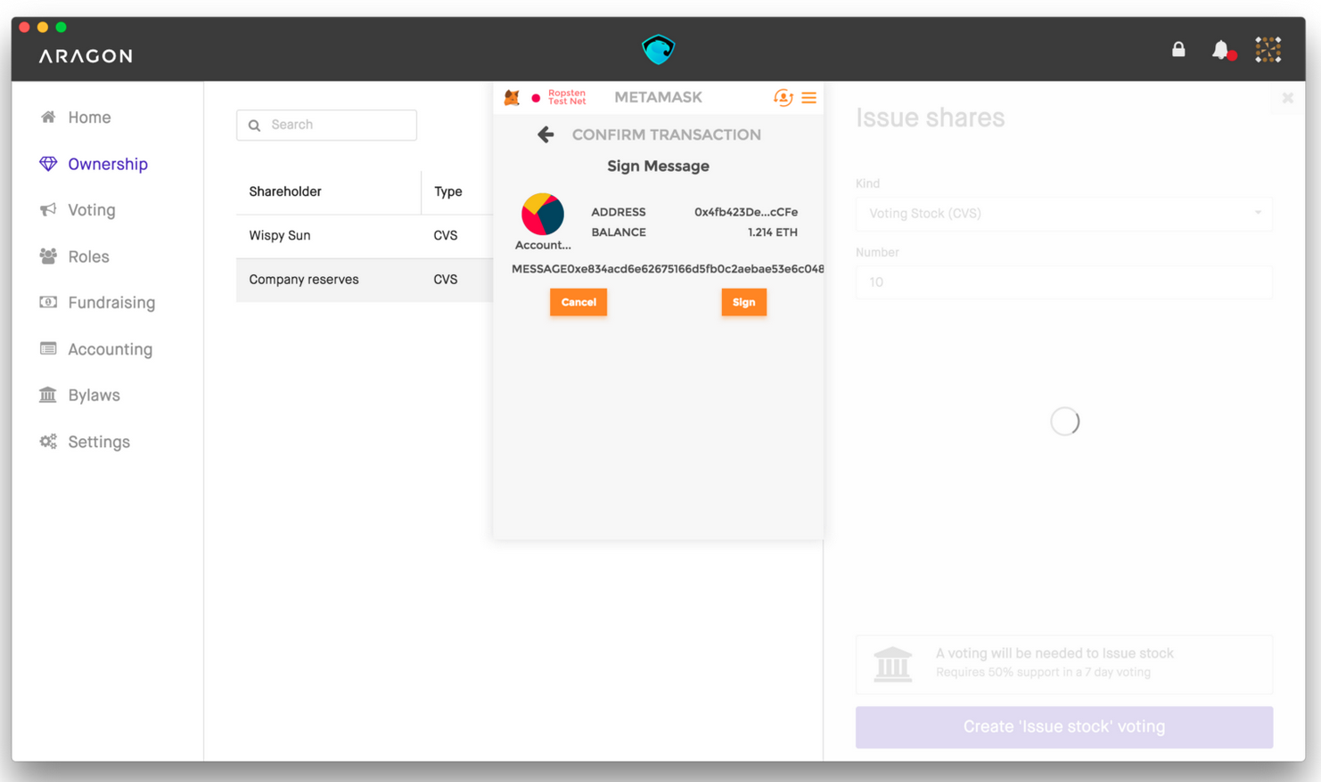
Introducing Aragon DApp
With Aragon you can
Easily create a company
Own, manage and transfer your shares
Raise capital from anywhere in the world
Easy integration with
Electron
MetaMask

Slide 32
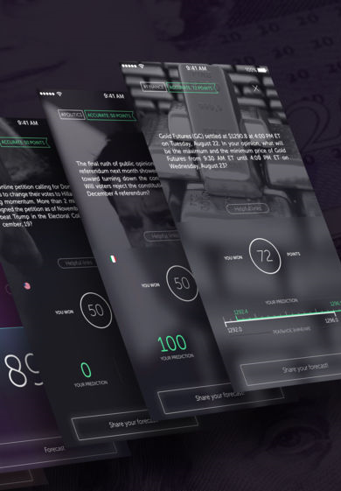
Cindicator – Invest Intellectual Efforts
Hybrid Intelligence for effective asset management
Cindicator bot
A system of predictive analytics, data, and market indicators
Working mobile app for Android / iOS
https://cindicator.com

Slide 33
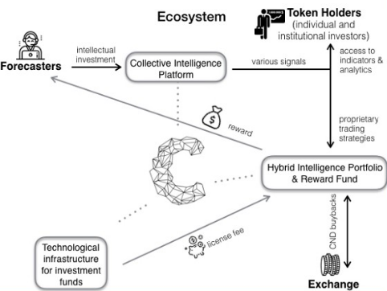
Cindicator Ecosystem

Slide 34
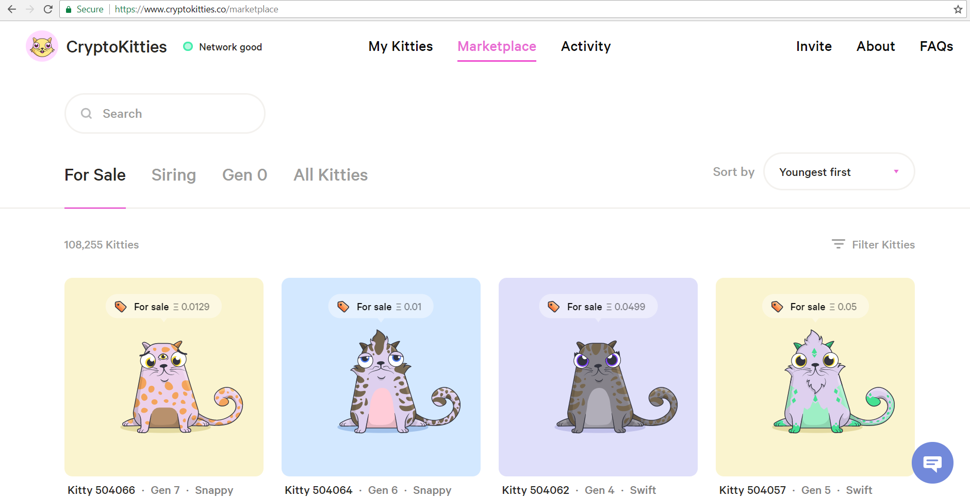
Crypto Kitties
Collect and breed crypto kitties
A game, running in the Ethereum network
Non-fungible tokens – ERC721
Connect with MetaMask
Buy / sell crypto kitties
https://www.cryptokitties.co
1/3 of the transactions in the Ethereum network in 12/2017
https://github.com/openblockchains/awesome-cryptokitties

Slide 35

Anonymous Marketplaces

Slide 36
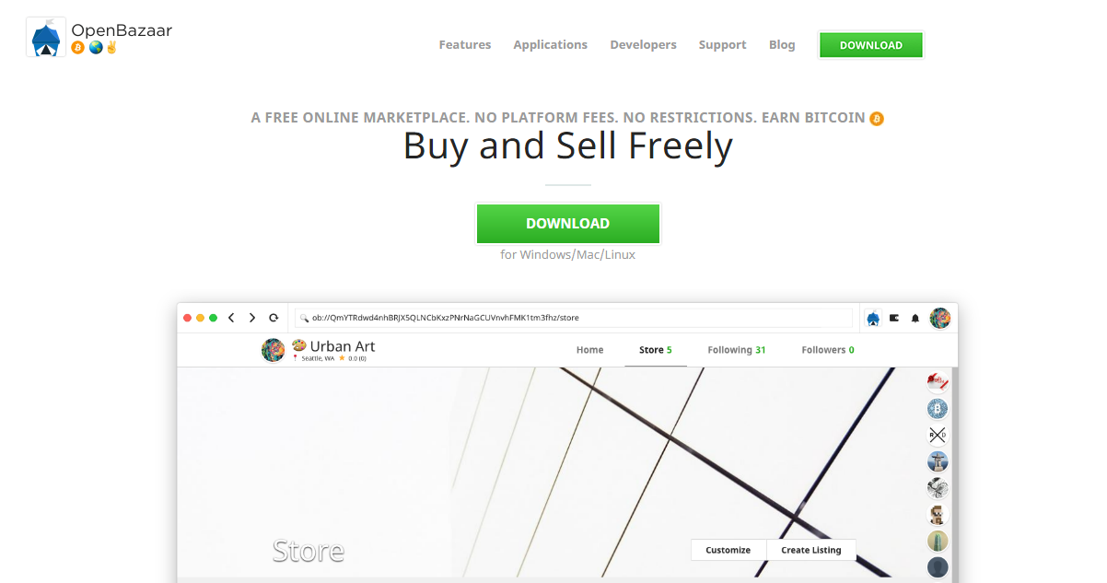
OpenBazaar – decentralized marketplace

Slide 37
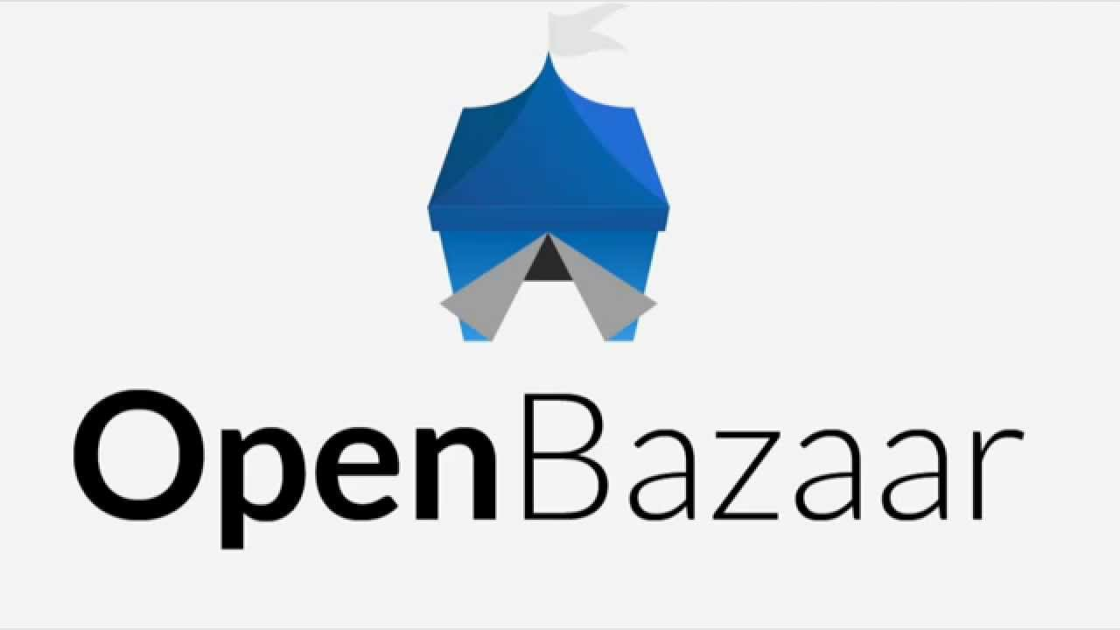
OpenBazaar – Decentralized Marketplace
OpenBazaar is a different approach to online commerce
OpenBazaar aims to be a decentralized version of eBay
It is built on the BitTorrent protocol
Bitcoin is used as a currency for transactions between sellers
OpenBazaar connects users directly
Notes:
OpenBazaar aims to be a decentralized version of Ebay. No middleman can tell sellers what they can and can’t sell or decide on the fees for using the service. It’s built on the BitTorrent protocol, but the problem is that the sellers must host their own stores. They need to have their own server and leave it on in order for users to be able to see their items. Ideally sellers could just upload their store data to the network, perhaps paying a small fee, without having to worry about it. This requires a decentralized system of incentivized storage miners. OpenBazaar uses BitTorrent’s protocol for data transfer and Bitcoin as currency for transactions between sellers.

Slide 38
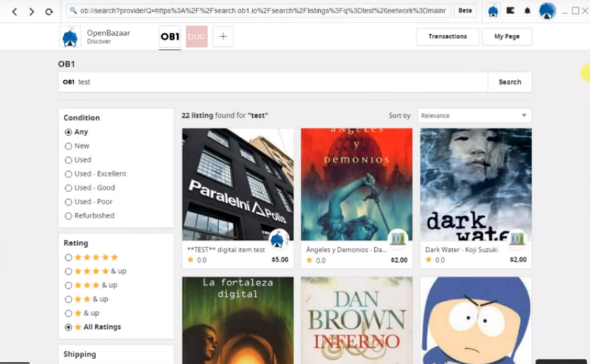
Download OpenBazaar 2.0
https://www.openbazaar.org/download

Slide 39
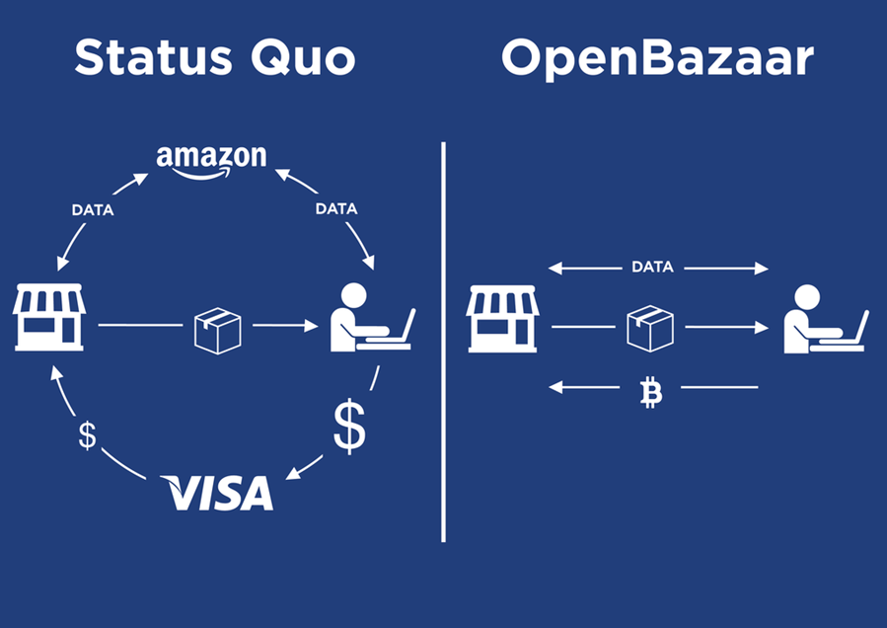
OpenBazaar vs. Amazon
Notes:
OpenBazaar is a different approach to online commerce. It puts the power back in the users’ hands. Instead of buyers and sellers going through a centralized service, OpenBazaar connects them directly. Because there is no one in the middle of your transactions there are no fees, no restrictions, no accounts to create, and you only reveal the personal information that you choose.

Slide 40
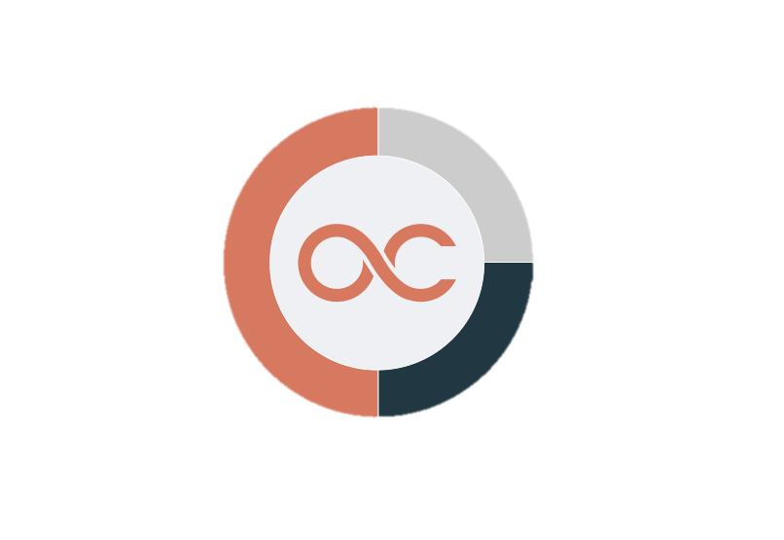


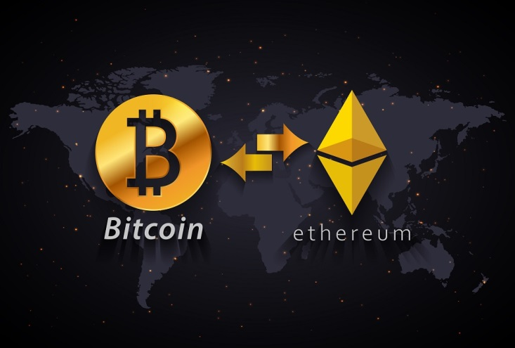

Summary
Decentralized apps (DApps)
Blockchain projects
Decentralized prediction markets
Anonymous marketplaces

Slide 41
Notable Blockchain Projects
http://www.kingsland.academy

Slide 42
Resources
https://www.coindesk.com
https://www.safaribooksonline.com
https://www.quora.com/What-are-decentralized-applications
https://lockchain.co/whitepaper_v1.2_t.pdf
https://tokensale.propy.com/Propy-White-Paper-17-Jul-2017.pdf
https://cindicator.com/Cindicator_WhitePaper_en.pdf
https://www.openbazaar.org
https://www.propy.com

